Slide 1
MODEL EXPLORATION
FINAL REPORT
RIGAT TEAM - JAN18

Slide 2
The Problem
Clients want to learn how their systems behave.
System represented by a stochastic FSM (Markov Chain)
Often, Models are too complicated for humans to get insights from
Lack of model separation/ abstraction
Even visualization is a challenge!

Slide 3
The solution
Transform the original model into a simplified one (model refinement)
Allow user to choose level of abstraction
A general algorithm to model refinement can be:
Identify clusters in the model
Generate a new model where each node is a cluster representative (supergraph)

Slide 4
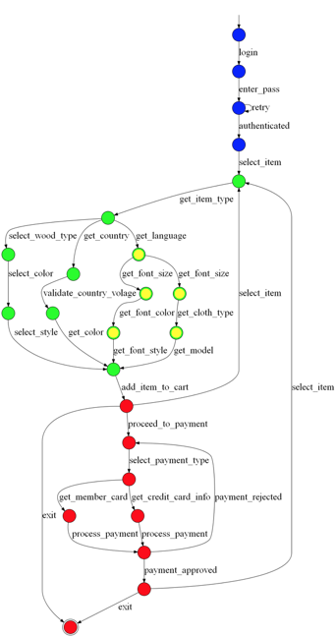

Slide 5
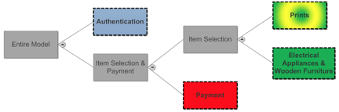

Slide 6
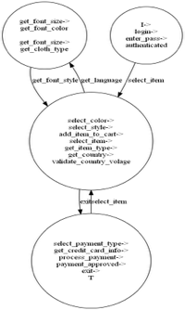

Slide 7
User Flow
Upload a .dot graph
Choose an algorithm and specify its parameters
Display hierarchical and abstract models
Interact & customize (zoom in & out)
Perform hierarchical clustering
Adjust the result
Web-App
Engine

Slide 8
Challenges - Technical:
Integrating multiple algorithms into one platform
Linking the web-app and Python engine
Providing the user with a tool to manipulate the result representation - D3 JS kit
Achieving high modularity for further development of the project

Slide 9
Challenges - Conceptual:
Create the “right” clustering without prior knowledge about the data.
Further dividing into relevant sub-groups to allow drill-down or zoom-out.
Providing good labeling to clusters
Customization - allowing the user as much power as possible.

Slide 10
Technologies
Engine - Python based
Libraries used: sci-kit, networkx, numPy and GEM
Web-App
Flask web framework for back-end (python)
JQuery and D3.js for front-end

Slide 11
Since midterm report:
Created 5 new non-trivial labeling schemes.
3 further clustering algorithms.
Added additional customization options to the user.
Implemented super-state graph view.
Improved UI/UX.
Tests, improved modularity, documentation, website, bug-fixes, adjustments, export graphs, ...

Slide 12
Algorithms
Spectral clustering
Minimum Cut
Branch & Bound - new
Kernighan–Lin algorithm - new
K - means - new
Notes:
Spectral clustering: cut that minimizes ratio of <cut out edges>/<outgoing edges> for both clusters simultaneously. Since this is integer optimization, it’s NP-hard. Relax to real numbers for an easy-to-calculate approximation.
Minimum-Cut: Easy to calculate. Ignores the idea of maximizing intra-cluster edges except implicitly.
Branch-and-Bound: prune the search tree as we build it - if lower bound heuristic for branch is higher than upper bound for a different branch, we can stop exploring said branch. Upper+lower bounds must be conservative heuristics in order not to lose potential solutions
Kerninghan-Lin - iteratively improve a partition by swapping vertices between clusters. Each iteration is the top k changes to the current partition.
K-means - embed graph into lower-dimensional space (spectral layout), use K-means there.

Slide 13
Labeling Schemes
Prefix
Tf-idf
Random Walk
PageRank
Path-based
Notes:
Prefix - merge prefix (e.g. ‘java.net.’), don’t lose info.
Tf-idf - rank labels in cluster according to tf-idf (compared to entire graph as document)
Random Walk - rank nodes according to random walk probability of ending up in one of them
PageRank - likewise
Path-based - every super-state has entrance and exit/sink nodes vertices. Choose random entrance node, best-first-search until sink. Rank
nodes according to external measure (e.g. by random walk probability, or tf-idf of node label, etc). Gives sequence

Slide 14
Demo

Slide 15
We would like to
THANK
Dr. Shahar Maoz & Mr. Nimrod Busany
And YOU
For listening!

